Slide 1

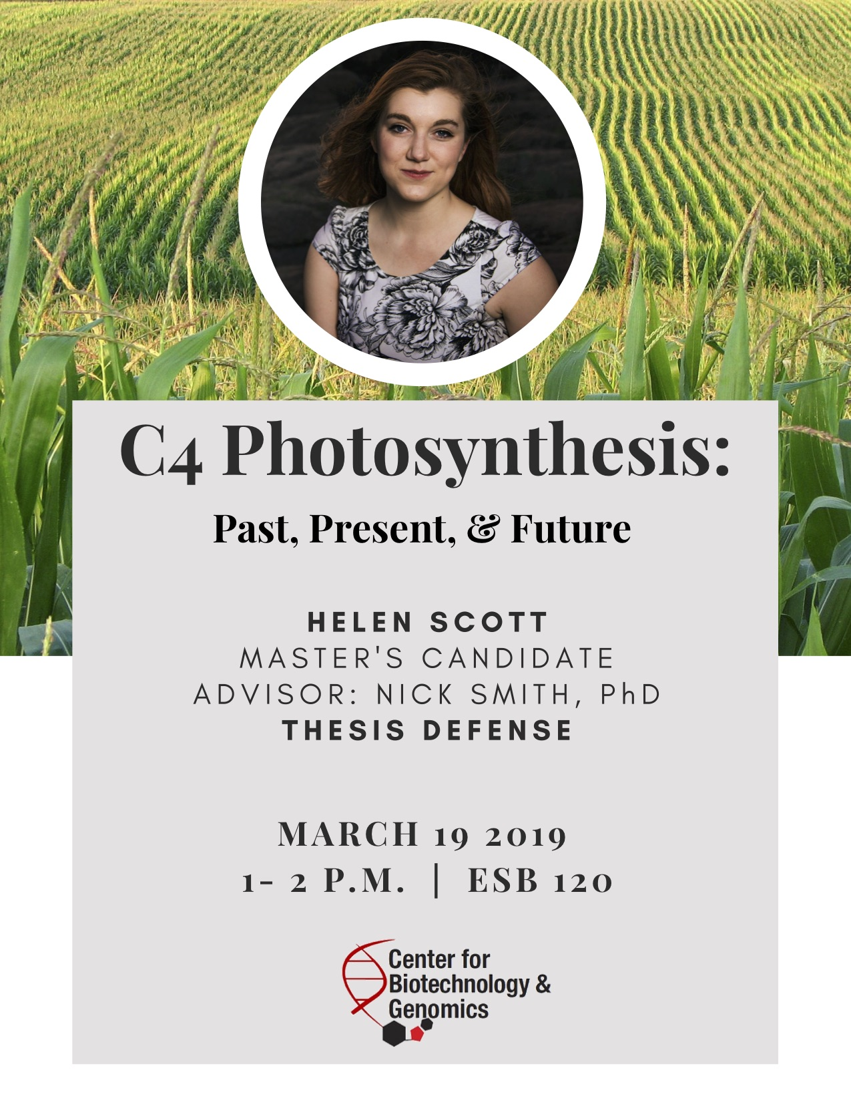
Photosynthetic acclimation through the lens of optimality
Nick Smith
Texas Tech University
nick.smith@ttu.edu; @nick_greg_smith
Lizz Waring
TTU
Helen Scott
TTU
Trevor Keenan
Berkeley Lab
Wang Han
Tsinghua U.
Colin Prentice
Imperial College

Slide 2
Photosynthesis is important!
nick.smith@ttu.edu; @nick_greg_smith

Slide 3
Photosynthesis is important!
nick.smith@ttu.edu; @nick_greg_smith
Data from IPCC (2013)

Slide 4
Photosynthesis is important!
nick.smith@ttu.edu; @nick_greg_smith
Photosynthesis
Data from IPCC (2013)

Slide 5
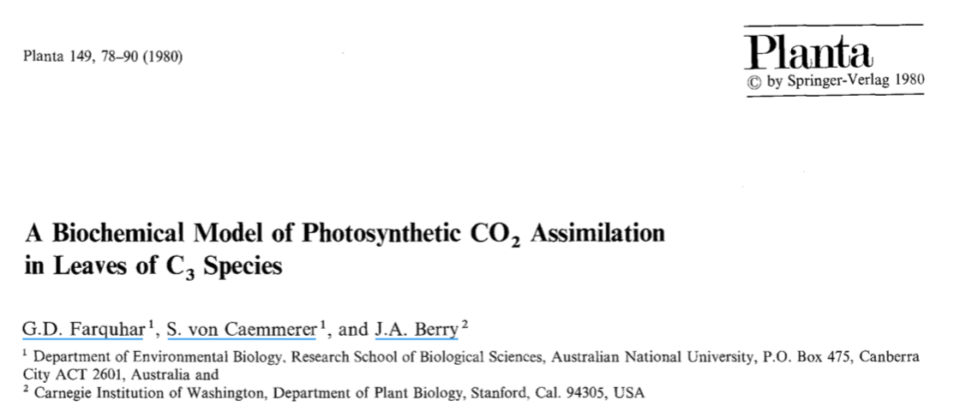
Theoretical models for photosynthesis exist
nick.smith@ttu.edu; @nick_greg_smith

Slide 6
And short-term responses are well known!
nick.smith@ttu.edu; @nick_greg_smith

Slide 7
Long-term responses can differ from short-term responses due to acclimation
nick.smith@ttu.edu; @nick_greg_smith

Slide 8
Long-term responses can differ from short-term responses due to acclimation
nick.smith@ttu.edu; @nick_greg_smith
Acclimated to high light
Acclimated to low light

Slide 9
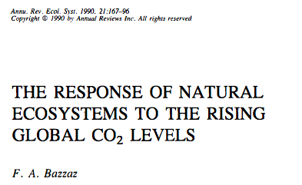
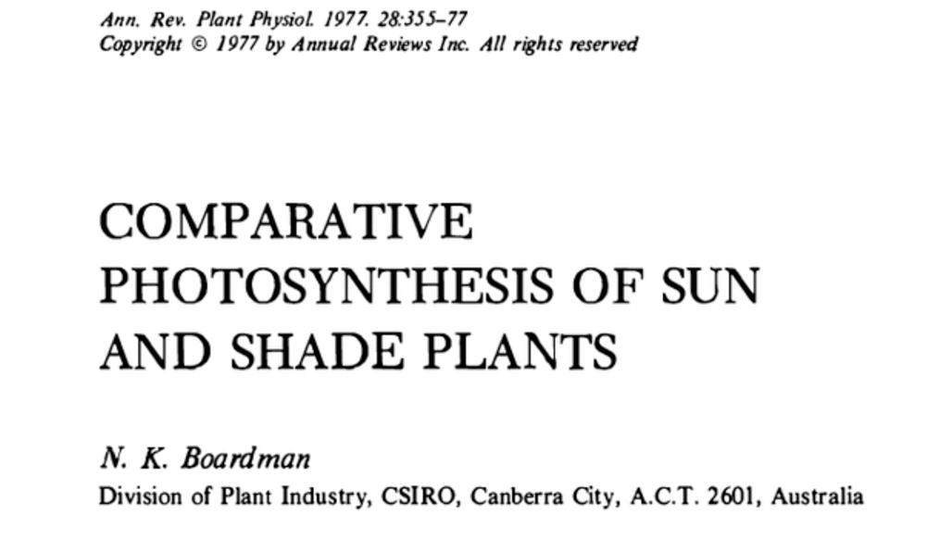
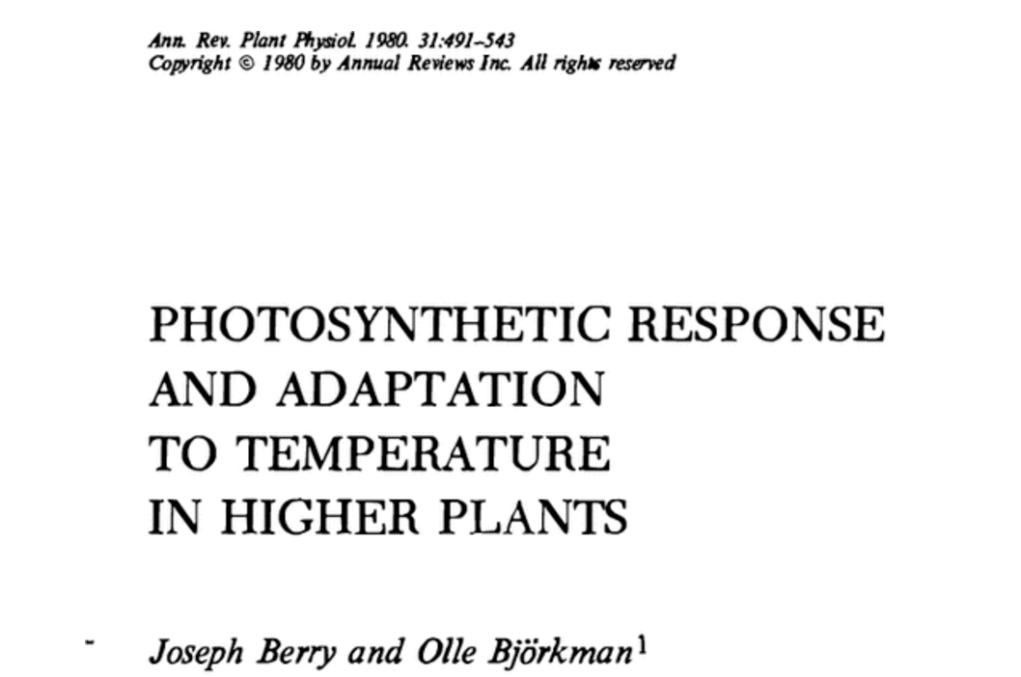
Acclimation is ubiquitous and well known…
nick.smith@ttu.edu; @nick_greg_smith
Temperature: Berry & Björkman (1980)
CO₂: Bazzaz (1990)
Light: Boardman (1977)

Slide 10
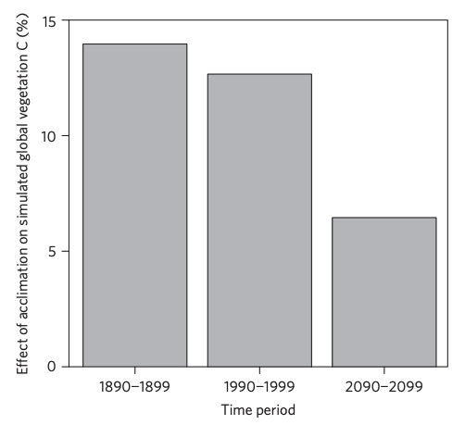
…and can impact carbon cycling and climate…
nick.smith@ttu.edu; @nick_greg_smith
Acclimation increase future C storage by ~6%
Acclimation alters future temperature by >1°C
Smith et al. (2017) Nature Climate Change
Smith et al. (2017) JAMES

Slide 11
…but the mechanisms underlying photosynthetic acclimation are not well known
nick.smith@ttu.edu; @nick_greg_smith

Slide 12
Solution: A testable, theoretical model!
nick.smith@ttu.edu; @nick_greg_smith

Slide 13
Least cost theory
nick.smith@ttu.edu; @nick_greg_smith
Maintain fastest rate of photosynthesis at the lowest cost (water and nutrient use)
Wright et al. (2003) American Naturalist

Slide 14
Biochemistry optimization: Coordination hypothesis
Photosynthesis may be limited by multiple processes

Slide 15
Biochemistry optimization: Coordination hypothesis
Photosynthesis may be limited by multiple processes
Optimally, plants will coordinate their biochemistry to be equally limited by these processes

Slide 16
Coordination of photosynthesis
nick.smith@ttu.edu; @nick_greg_smith
Optimally…
A_{c} = A_{j}
Electron transport-limited photosynthesis
Carboxylation-limited photosynthesis

Slide 17
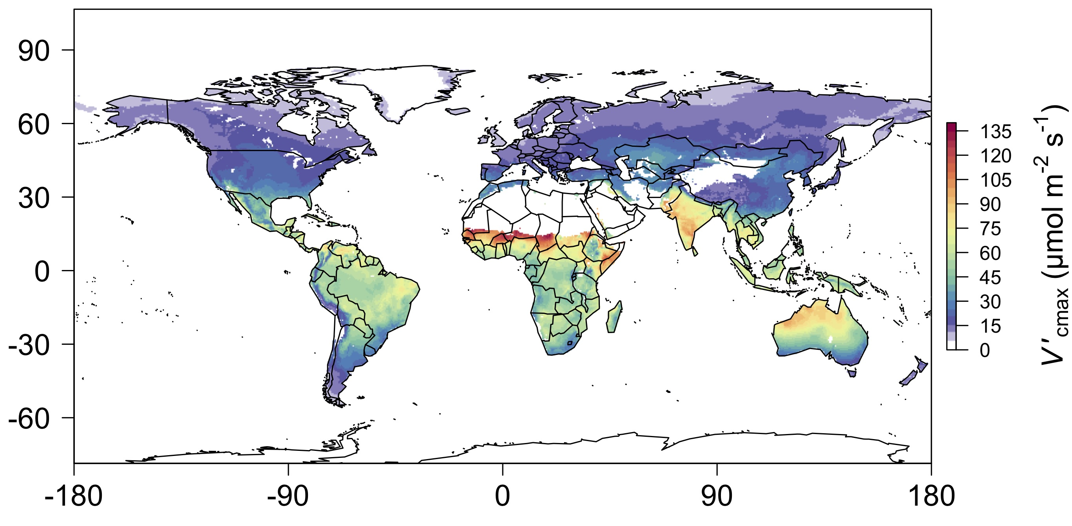
nick.smith@ttu.edu; @nick_greg_smith
We can predict optimal traits in different envionrments
Smith et al. (2019) Ecology Letters

Slide 18
Ok, great, but now what?
nick.smith@ttu.edu; @nick_greg_smith

Slide 19
Let’s tackle some big questions in plant ecophysiology!
nick.smith@ttu.edu; @nick_greg_smith

Slide 20
Question 1: Is photosynthesis optimized to the environment?
nick.smith@ttu.edu; @nick_greg_smith

Slide 21
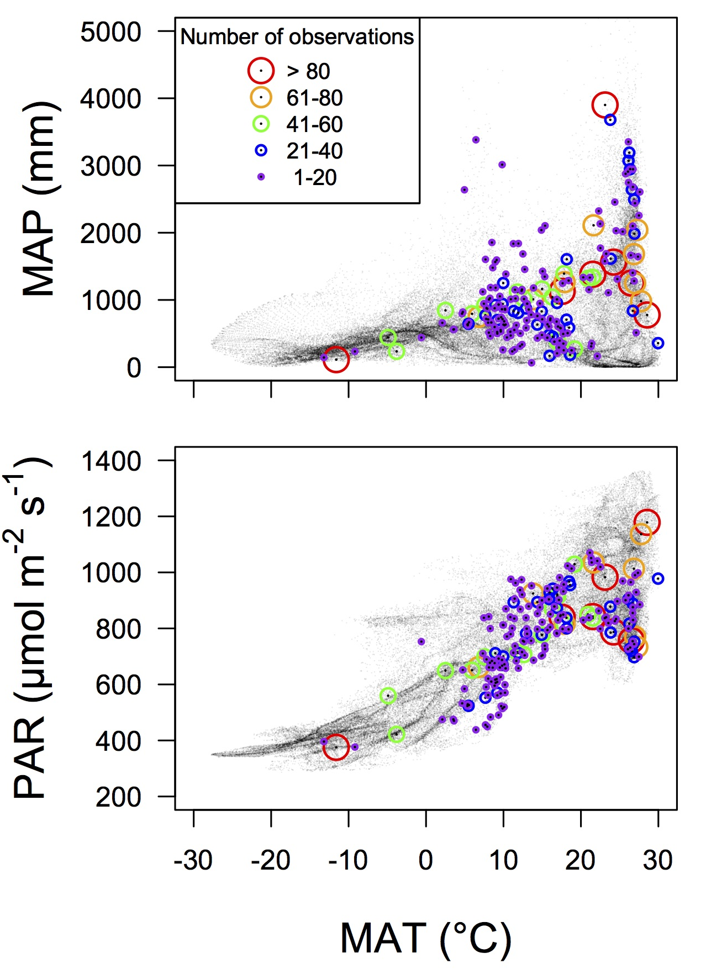
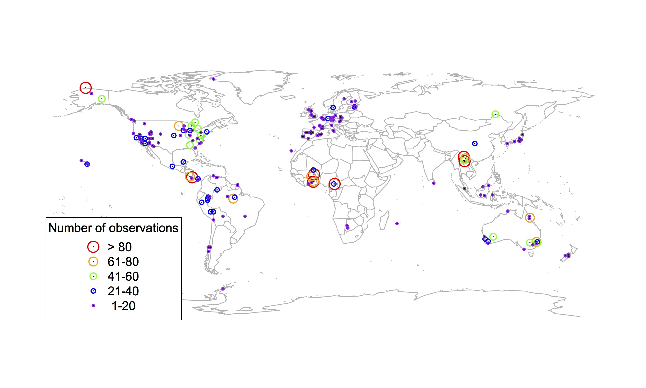
Global V_{cmax} dataset
nick.smith@ttu.edu; @nick_greg_smith
3,697 measurements
202 sites
> 600 genera
Smith et al. (2019) Ecology Letters

Slide 22

nick.smith@ttu.edu; @nick_greg_smith
Smith et al. (2019) Ecology Letters

Slide 23
Question 1: Is photosynthesis optimized to the environment? YES! Photosynthesis acclimates spatially as expected from optimization
nick.smith@ttu.edu; @nick_greg_smith

Slide 24
Question 2: How will photosynthesis acclimate to future conditions?
nick.smith@ttu.edu; @nick_greg_smith

Slide 25
Photosynthetic traits change with temperature and CO₂ in ways expected from optimization
nick.smith@ttu.edu; @nick_greg_smith
Smith and Keenan (in prep)

Slide 26
Photosynthetic traits change with temperature and CO₂ in ways expected from optimization
nick.smith@ttu.edu; @nick_greg_smith
Fully acclimated response
Smith and Keenan (in prep)

Slide 27
Photosynthetic traits change with temperature and CO₂ in ways expected from optimization
nick.smith@ttu.edu; @nick_greg_smith
mean: -12%
mean: -15%
(P > 0.05)
Smith and Keenan (in prep)

Slide 28
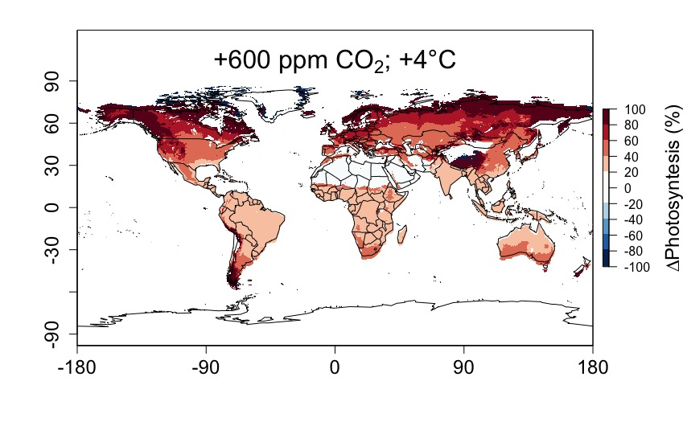
Higher CO₂ and increased temperatures increase future photosynthesis
nick.smith@ttu.edu; @nick_greg_smith
Smith and Keenan (in prep)

Slide 29
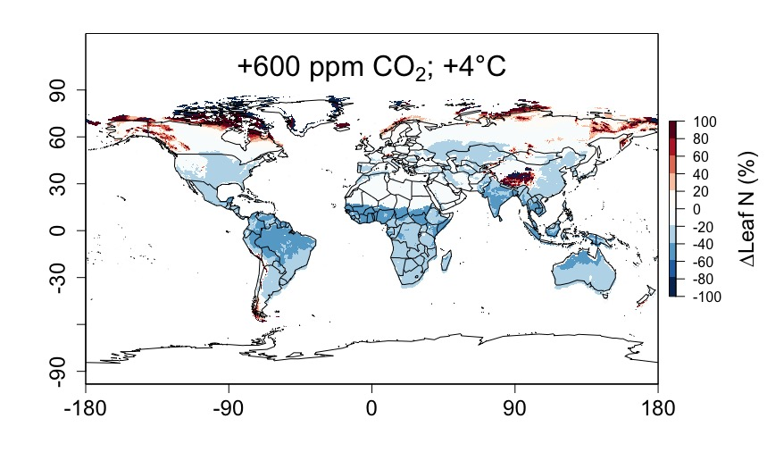
Higher CO₂ and increased temperatures increase future photosynthesis (at lower nutrient use)
nick.smith@ttu.edu; @nick_greg_smith
Smith and Keenan (in prep)

Slide 30
Question 2: How will photosynthesis acclimate to future conditions? Photosynthesis will increase and per-leaf-area nutrient use will decrease
nick.smith@ttu.edu; @nick_greg_smith

Slide 31
Question 3: Does photosynthesis respond to nutrient addition?
nick.smith@ttu.edu; @nick_greg_smith
Lizz Waring
TTU

Slide 32
From the least cost hypothesis…
nick.smith@ttu.edu; @nick_greg_smith
Added nutrients will not increase photosynthesis because light limitation will kick in

Slide 33
From the least cost hypothesis…
nick.smith@ttu.edu; @nick_greg_smith
Added nutrients will not increase photosynthesis because light limitation will kick in
Optimal response would be to increase leaf area

Slide 34
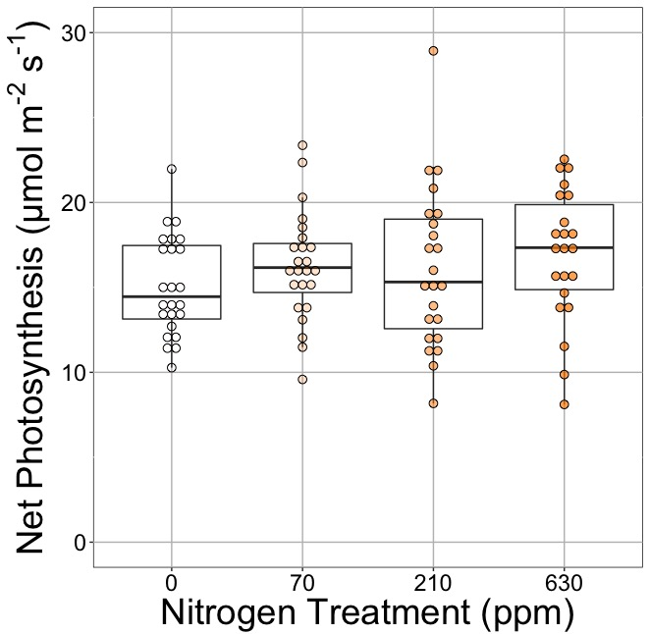
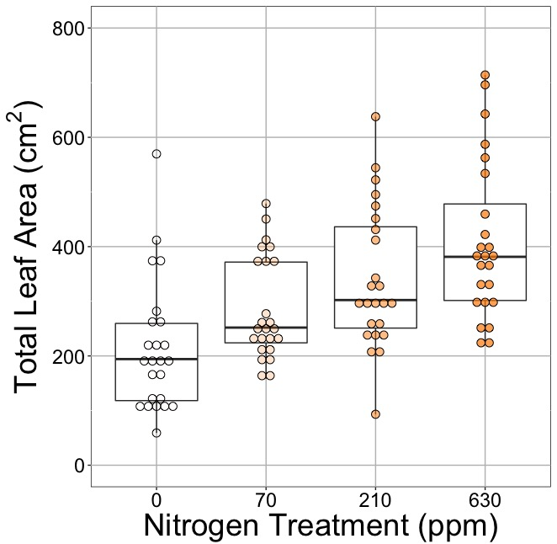
Leaf area, but not photosynthesis increases with N addition
nick.smith@ttu.edu; @nick_greg_smith
Waring and Smith (in prep)

Slide 35
Leaf area, but not photosynthesis increases with N addition
nick.smith@ttu.edu; @nick_greg_smith
Waring and Smith (in prep)

Slide 36
Leaf area, but not photosynthesis increases with N addition
nick.smith@ttu.edu; @nick_greg_smith
Waring and Smith (in prep)

Slide 37
But do greenhouse experiments translate to the field?

Slide 38
Grassland soil nutrient addition network:
Leaf area index
Per-leaf-area nitrogen (photosynthetic proxy)

Slide 39
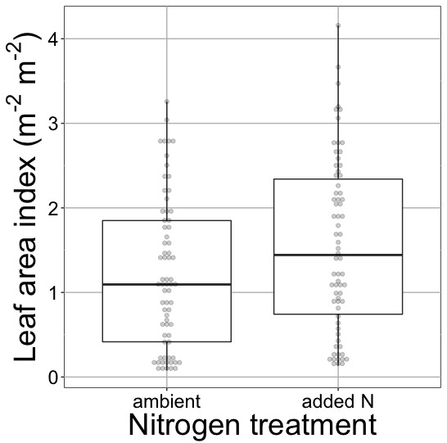
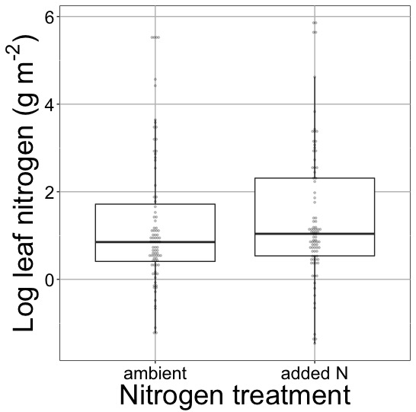
Globally, N addition increases leaf area, not leaf N
nick.smith@ttu.edu; @nick_greg_smith
41% increase (P < 0.05)
No change (P = 0.42)
Waring and Smith (in prep)

Slide 40
Question 3: Does photosynthesis respond to nitrogen addition? No, plants respond to added nitrogen by increasing leaf area, not photosynthesis
nick.smith@ttu.edu; @nick_greg_smith

Slide 41
Question 4: Will C₄ be advantageous in the future?
nick.smith@ttu.edu; @nick_greg_smith
Helen Scott
TTU

Slide 42
nick.smith@ttu.edu; @nick_greg_smith
Relative advantage of C₄ physiology
Scott and Smith (in prep)

Slide 43
nick.smith@ttu.edu; @nick_greg_smith
Relative advantage of C₄ physiology
Scott and Smith (in prep)

Slide 44
Question 4: Will C₄ be advantageous in the future? Elevated CO₂ will negate C₄ advantages in the future
nick.smith@ttu.edu; @nick_greg_smith

Slide 45
Conclusions
Theory can be useful!
Improving the reliability of climate models
Acting as a null model for understanding mechanisms

Slide 46
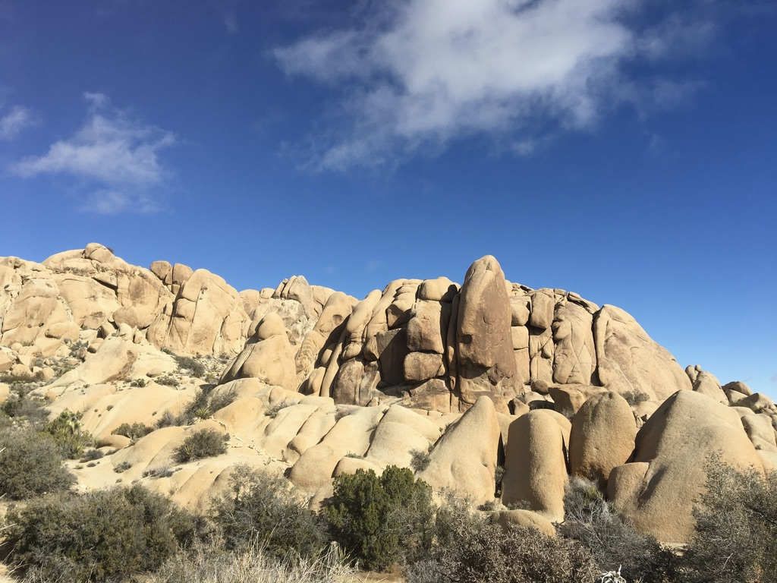
nick.smith@ttu.edu; @nick_greg_smith
Presentation available at:
www.github.com/SmithEcophysLab/ESA_2019
Thanks!

Slide 47
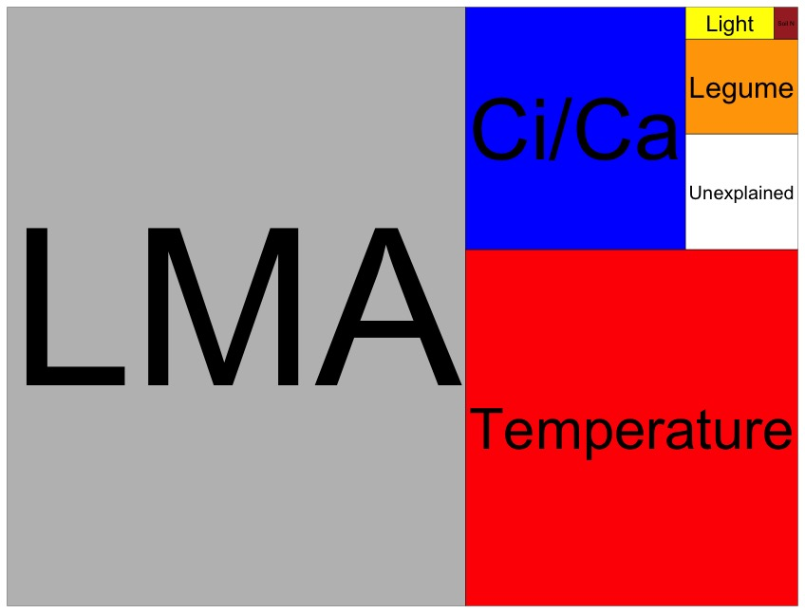
Globally, N addition has no impact on leaf N
nick.smith@ttu.edu; @nick_greg_smith
Each box is proportional to the variance in leaf N explained by each variable
Waring and Smith (in prep)

